Slide 1
CS2105 Introduction to Computer Networks

Slide 2
Admin
When you check your emails for the slides, do take time to read the content of the email.
I try to explain concepts that were left hanging in class there, which can be useful for midterm revision.

Slide 3
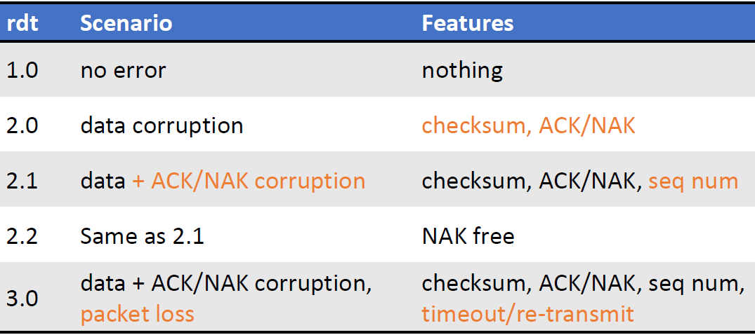
Recap
RDT
Start from a perfect protocol and slowly introduce errors
Reduce dependence on unreliable network layer
FSMs model how all possible events are connected to each other by means of event occurrences and corresponding actions taken

Slide 4
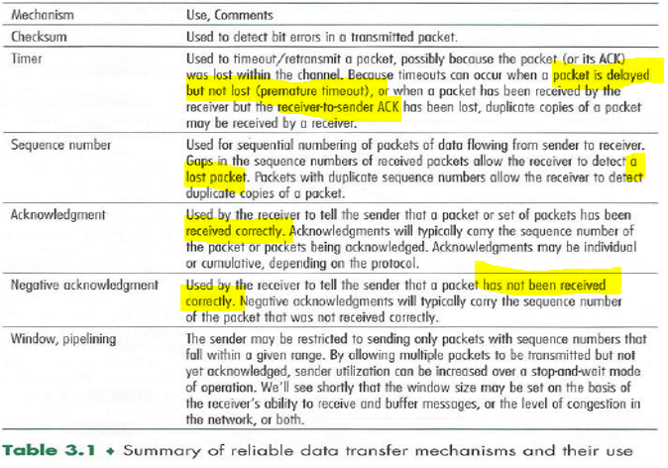
Recap
Notes:
Highlighted portions hint at situations when the mechanism is useful. Try to understand and construct situations that illustrate their usefulness ☺

Slide 5
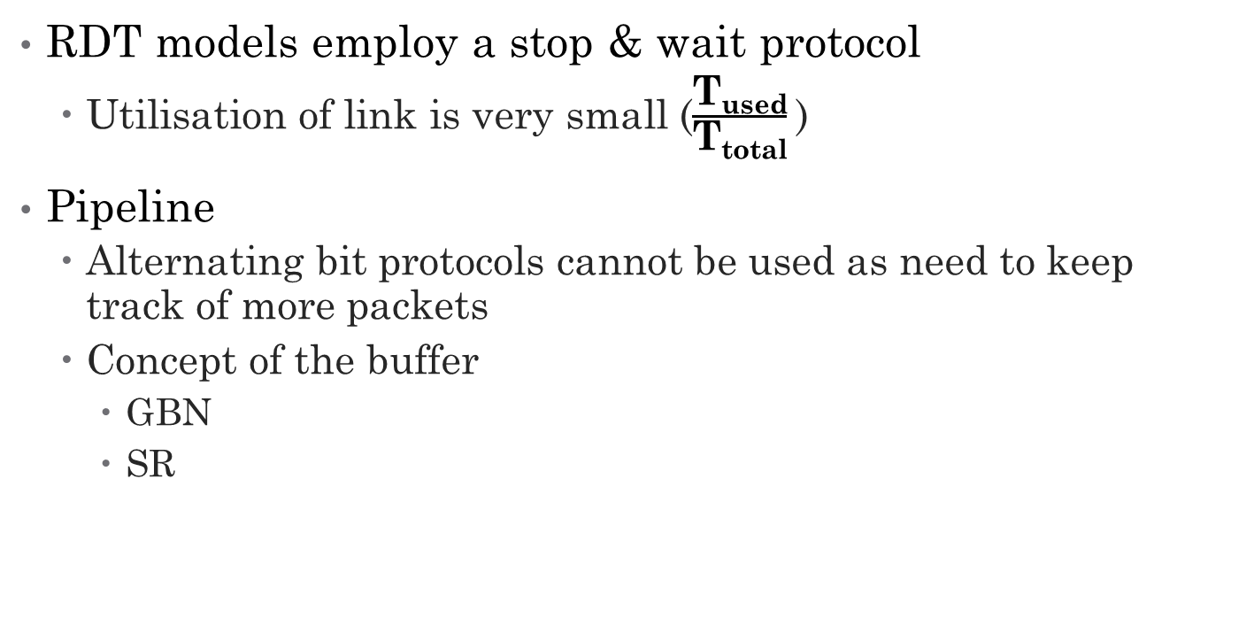
Recap
RDT models employ a stop & wait protocol
Utilisation of link is very small ($\frac{\text{T}\text{used}}{\text{T}\text{total}}$)
Pipeline
Alternating bit protocols cannot be used as need to keep track of more packets
Concept of the buffer
GBN
SR

Slide 6
Recap
Go-Back N
ACKs are cumulative
If ACK n has been received, I can be sure that packets 0 to n have been received
Don’t have to receive every single ACK to be sure that all packets have been received, just need the “latest” ACK
Sender
Has a size N buffer to keep track of N unACKed packets
Transmission will stop if buffer is full, even if there are more packets to be sent
Maintains a timer for oldest unACKed packet
On timeout, retransmit the whole buffer
Why?
Receiver
Has no buffer
Discards all out of order packets
Just need to track expected seq num

Slide 7
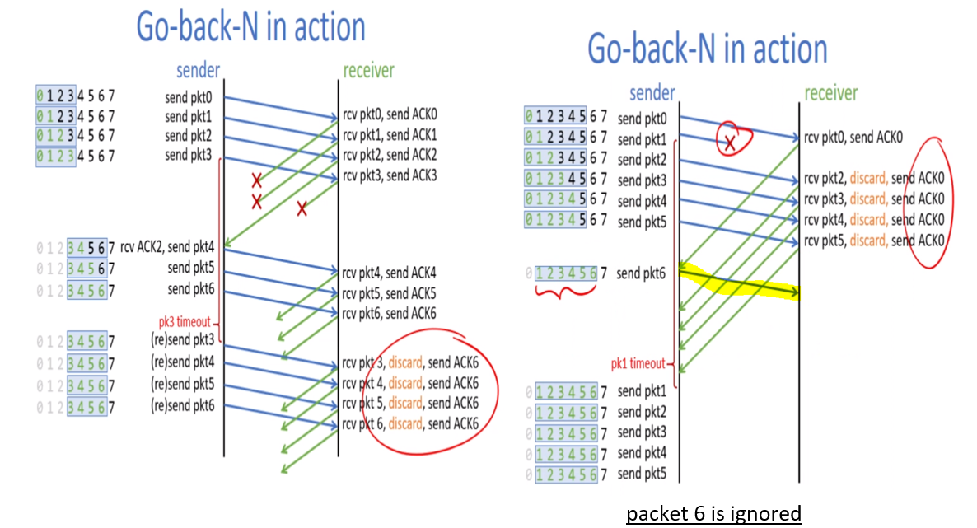
Recap
Notes:
Notice how even though the rest of the ACKs were dropped, the start of the buffer was able to shift from 0 to 3.
Also notice that on timeout, the entire buffer was retransmitted. This is because the sender cannot be sure that any of the packets actually reached the receiver.
Since the receiver has no concept of a buffer, if the sender can’t be sure that packet 3 has successfully reached the receiver, it can’t be sure that the rest of the packets also reached the receiver.
For this example, where the receiver has already received packet 6, as long as it does not receive the expected packet 7, he will keep resending the ACK that will prompt the sender to send packet 7, which is ACK6.
=======================================================================================================
Remember as there is no buffer on the receiver side, any out of order packets are dropped. This means that a faulty packet 1 will cause the rest of the ensuing packets to be discarded, and resend an ACK that forces a rtx of packet 1. You can see the resending of the entire buffer on timeout here again in this example.

Slide 8
Recap
Selective Repeat (SR)
ACKs are specific for their individual packet, NOT CUMULATIVE
If I receive an ACK n, I can only be sure that packet n has been received, nothing else.
Sender
Maintains a timer for each unACKed packet
On timeout, only retransmit the timedout packet
Receiver
Flexibility requires a buffer (again, expensive)
Having independent ACKs allows for out of order packets but need to be held in a buffer till the packets form a sequential stream to be pushed into the app layer

Slide 9
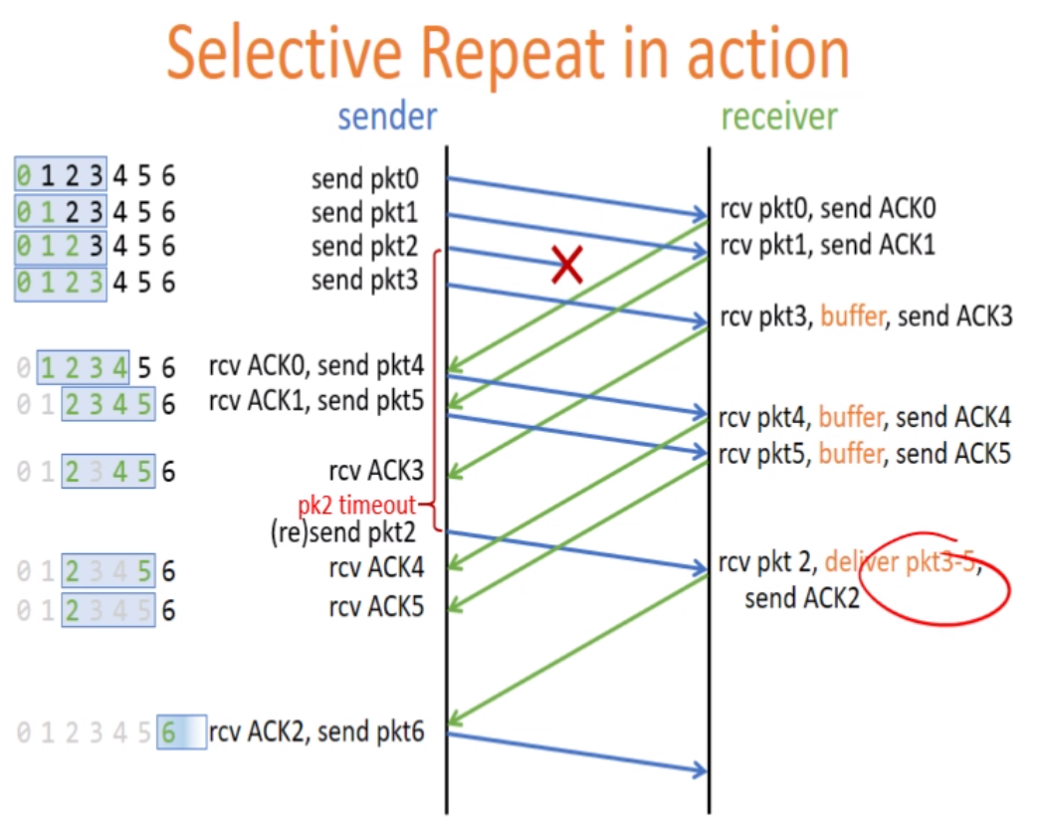
Recap
Notes:
Notice how the window’s send base is not updated until the individual ACKs for each packet has been received.
Also note that on timeout, only the individual packet that has timedout is rtx.

Slide 10
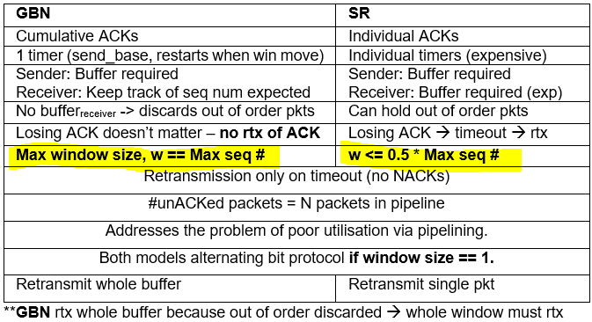
Recap

Slide 11
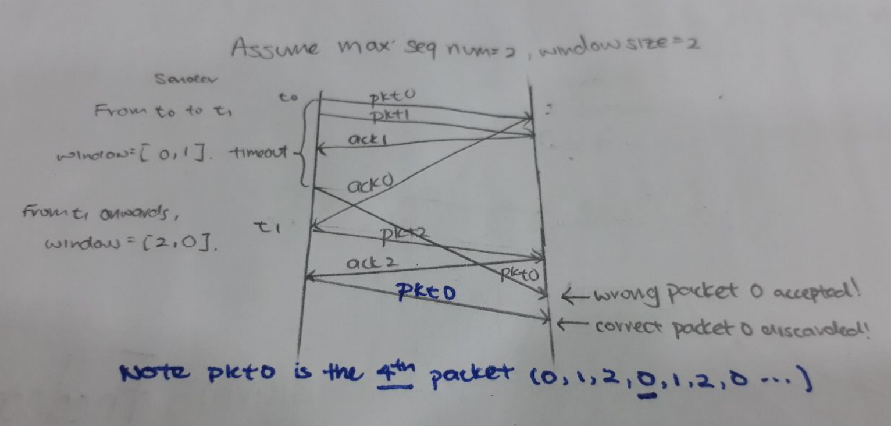
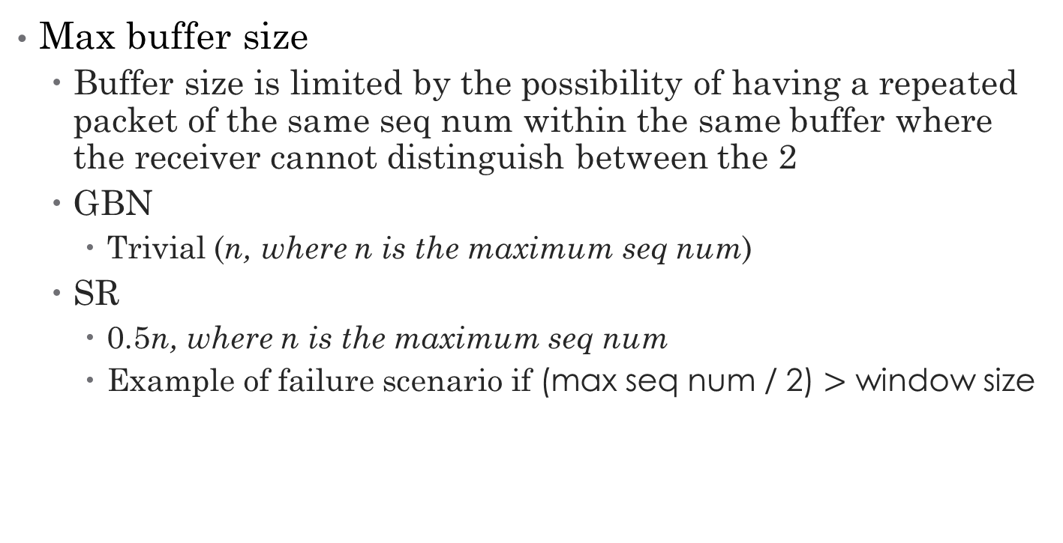
Recap
Max buffer size
Buffer size is limited by the possibility of having a repeated packet of the same seq num within the same buffer where the receiver cannot distinguish between the 2
GBN
Trivial (n, where n is the maximum seq num)
SR
0.5n, where n is the maximum seq num
Example of failure scenario if (max seq num / 2) $>$ window size

Slide 12
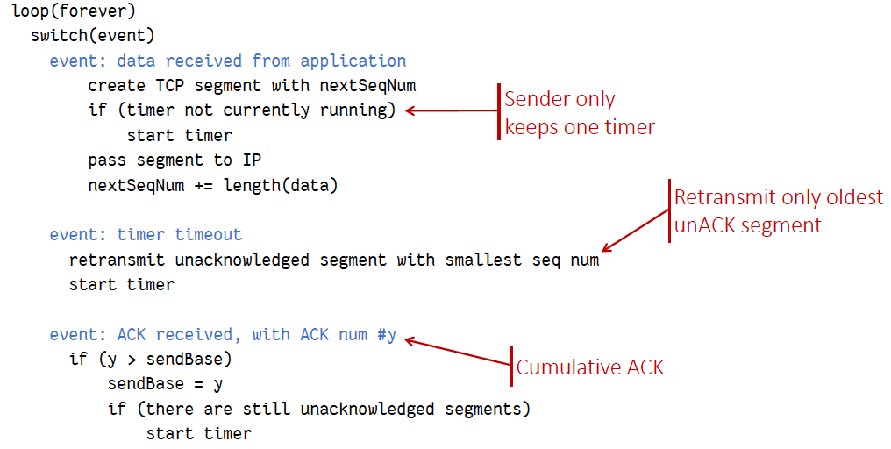
Recap
TCP
Seq num (range, start)
Span a huge number to prevent duplicate sequence numbers to reduce duplicate packets which could lead to message reordering
Start from a random point so as to prevent malicious attackers from pre-empting the next sequence number due to its predictability
Sender events
Notes:
Range for more seq num to maximise buffer size to maximise link utilisation
1. Looping forever, whenever an event occurs that requires a message to be sent, I will create a TCP segment with next sequence number.
2. Start a timer for timeout tracking purposes
3. If timeout, transmits only the smallest unACKed segment
4. If ACK received, update send base to the new ACK to update the cumulative ACK.

Slide 13
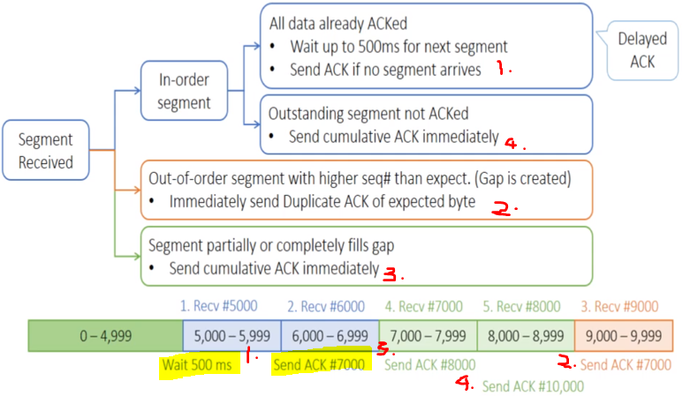
Recap
TCP receiver events
Notes:
Graphical representation of slide 33 lecture 5 with an example ☺

Slide 14
Recap
TCP timeout value
Too long suboptimal
Too short many rtx
Must minimally be larger than RTT !
Use Estimated Weighted Moving Average to estimate RTT

Slide 15
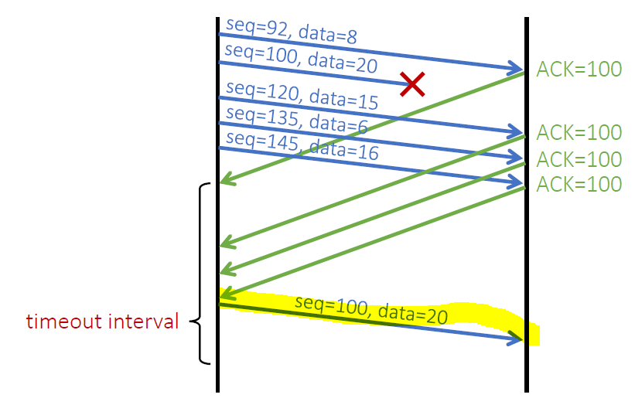
Recap
TCP fast retransmission
If many duplicate ACKs are received, the sender knows that the network is fine
Can immediately send the packet specified by the duplicate ACKs
No need to wait for timeout!

Slide 16
Tutorial Questions

Slide 17
Question 1
[KR, Chapter 3, R6] Is it possible for an application to enjoy reliable data transfer even when the application runs over UDP? If so, how?
Note: this is exactly what you are supposed to do in Assignment 2. ☺
One would have to implement reliability checking and recovery mechanisms (ACK, seq #, checksum, timeout, re-transmission, etc.) at application layer. For example, sender needs to include relevant header/trailer fields in every packet (as illustrated below).

Slide 18
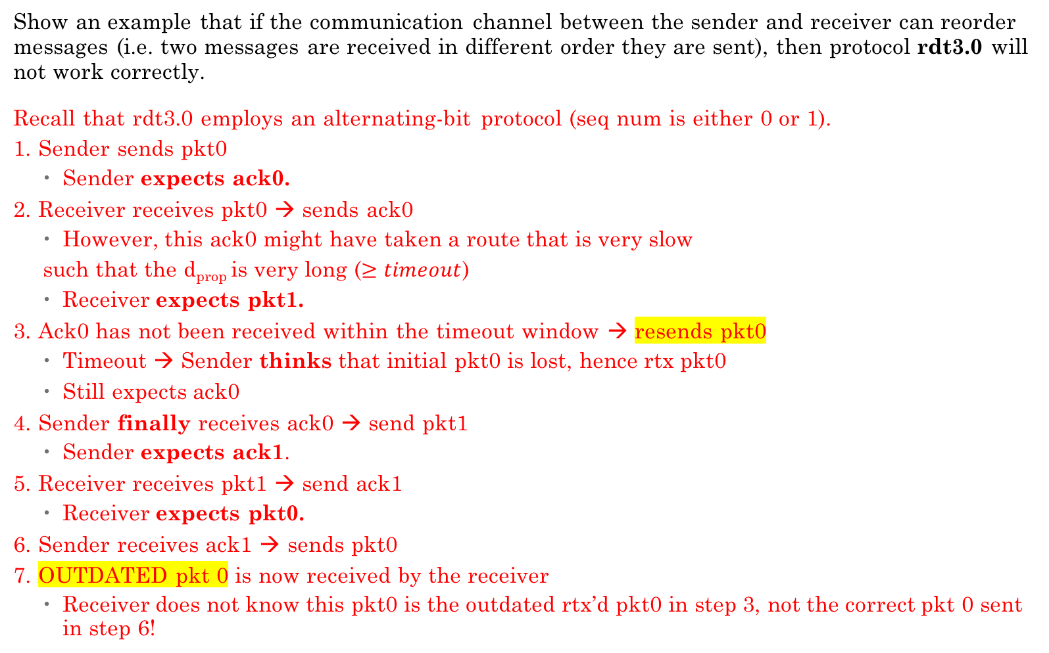
Question 2
Show an example that if the communication channel between the sender and receiver can reorder messages (i.e. two messages are received in different order they are sent), then protocol rdt3.0 will not work correctly.
Recall that rdt3.0 employs an alternating-bit protocol (seq num is either 0 or 1).
1. Sender sends pkt0
Sender expects ack0.
2. Receiver receives pkt0 → sends ack0
However, this ack0 might have taken a route that is very slow
such that the d_{prop} is very long ($≥timeout$)
Receiver expects pkt1.
3. Ack0 has not been received within the timeout window → resends pkt0
Timeout → Sender thinks that initial pkt0 is lost, hence rtx pkt0
Still expects ack0
4. Sender finally receives ack0 → send pkt1
Sender expects ack1.
5. Receiver receives pkt1 → send ack1
Receiver expects pkt0.
6. Sender receives ack1 → sends pkt0
7. OUTDATED pkt 0 is now received by the receiver
Receiver does not know this pkt0 is the outdated rtx’d pkt0 in step 3, not the correct pkt 0 sent in step 6!
Notes:
rtx = retransmission ☺

Slide 19
Question 3
[KR, Chapter 3, P29] It is generally a reasonable assumption, when sender and receiver are connected by a single wire, that packets cannot be reordered within the channel between the sender and receiver. However, when the “channel’ connecting the two is a network, packet reordering may occur. One manifestation of packet reordering is that old copies of a packet with a sequence or acknowledgement number of x can appear, even though neither sender’s nor receiver’s window contains x. With packet reordering, the channel can be thought of as essentially buffering packets and spontaneously emitting these packets at any point in the future. What is the approach taken in practice to guard against such duplicate packets?
The approach taken in practice is to ensure that a sequence number is not reused until the sender is “sure” that any previously sent packets with the same sequence number are no longer in the network.
Firstly, TCP use large sequence number field (32-bit) to lower the chance a sequence number is to be reused. Secondly, a packet cannot “live” in the network forever. For example, IP protocol specifies TTL in packet header to ensure that datagrams do not circulate infinitely in the network. This field is decreased by one each time the datagram arrives at a router along the end-to-end path. If TTL field reaches 0, router will discard this datagram. In practice, a maximum packet lifetime of approximately three minutes is assumed in the TCP extensions for high-speed networks.
Another way to avoid duplicate packets is by having a randomised sequence number. This is an especially useful way to also guard against attackers. Basically, in establishing your TCP 3way handshake, the syn packet will contain the randomised seq number that the hosts will be using in message exchange. Hence, attackers cannot predict which seq number the message exchange starts from and hence cannot send bogus packets that can be disguised within the rest of the packets.
Notes:
For example, if seq number always started from 0, then if an attacker knew that host A is going to talk to host B, it can easily disguise itself as A and send packets with seq number of 0. Randomisation makes it such that the seq number is very difficult to guess by the attacker, thus making him unable to insert packets.

Slide 20
Question 4
[Modified from KR, Chapter 3, P37] Host A is sending data segments to Host B using a reliable transport protocol (either GBN or SR). Assume timeout values are sufficiently large such that all data segments and their corresponding ACKs can be received (if not lost in the channel) by Host B and the Host A respectively. Suppose Host A sends 5 data segments to Host B and the 2nd data segment is lost. Further suppose retransmission is always successful. In the end, all 5 data segments have been correctly received by Host B.
How many segments has Host A sent in total and how many ACKs has Host B sent in total if either GBN or SR protocol is used? What are their sequence numbers? Answer this question for both protocols.
GBN: Host A sends 9 segment. They are initially sent segments 1, 2, 3, 4, 5 and later resent segments 2, 3, 4 and 5. Host B sends 8 ACKs. They are 4 ACKs with seq # 1 and 4 ACKs with seq # 2, 3, 4 and 5.
SR: Host A sends 6 segment. They are initially sent segments 1, 2, 3, 4, 5 and later resent segment 2. Host B sends 5 ACKs. They are 4 ACKs with seq # 1, 3, 4, 5 and 1 ACK with seq # 2 (for resent segment).

Slide 21
Question 5
[KR, Chapter 3, R15] Suppose Host A sends two TCP segments back to back to Host B over a TCP connection. The first segment has sequence number 65; the second has sequence number 92.
a) How much data is in the first segment?
92 – 65 = 27 bytes
b) Suppose that the first segment is lost but the second segment arrives at B. In the acknowledgment that Host B sends to Host A, what will be the acknowledgment number?
65. Note that TCP acknowledgment is cumulative and states the expected in-order sequence number.

Slide 22
Question 6 part 1
[KR, Chapter 3, P26] Consider transferring an enormous file of L bytes from Host A to Host B. Assume an MSS of 512 bytes.
1. What is the maximum value of L such that TCP sequence numbers are not exhausted? Recall that the TCP sequence number field is 32 bits.
TCP sequence number doesn’t increase by one with each TCP segment. Rather, it increases by the number of bytes of data sent. Therefore the size of the MSS is irrelevant here -- the maximum size file that can be sent from A to B without exhausting TCP sequence number is simply 2³² bytes.

Slide 23
Question 6 part 2
For the L you obtain in (a), find how long it takes to transmit this file. Assume that a total of 64 bytes of transport, network, and data-link header are added to each packet before the resulting packet is sent out over a 155 Mbps link. Ignore flow control, congestion control and assume Host A can pump out all segments back to back and continuously.
Remember to convert bytes into bits!!
Number of packets = L / MSS = 2³² / 512 = 8,388,608
64 bytes of headers will be added to each packet. Therefore,
Total bytes sent = 2³² + 8388608 * 64 = 4,831,838,208 bytes
Transmission delay = 4831838208 * 8 / (155 * 10⁶) ≈ 249 seconds

Slide 24
Summary
RDT
Buffers
GBN and SR

Slide 25
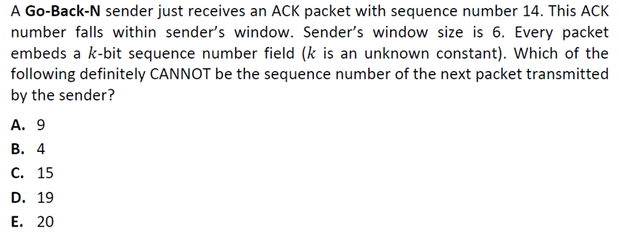
Extra Questions

Slide 26
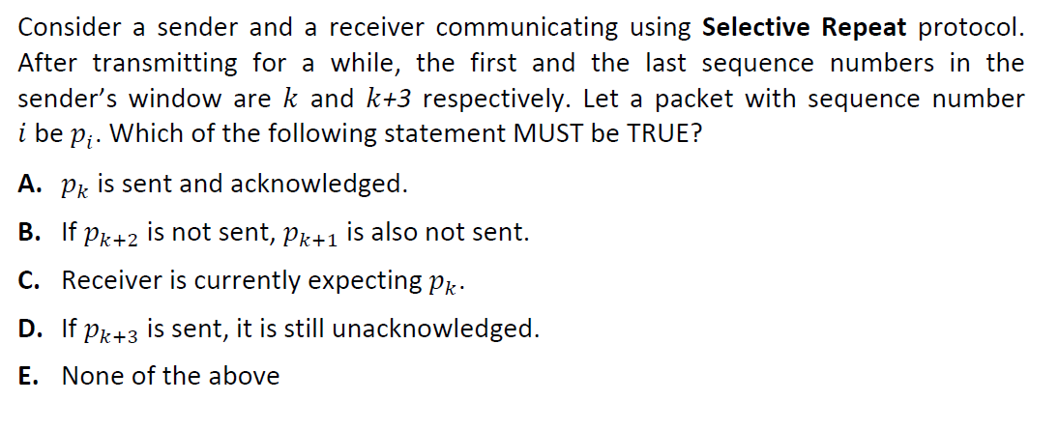
Extra Questions

Slide 27
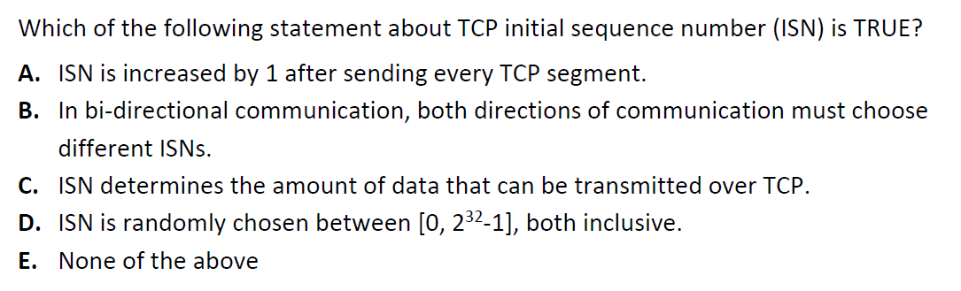
Extra Questions

Slide 28
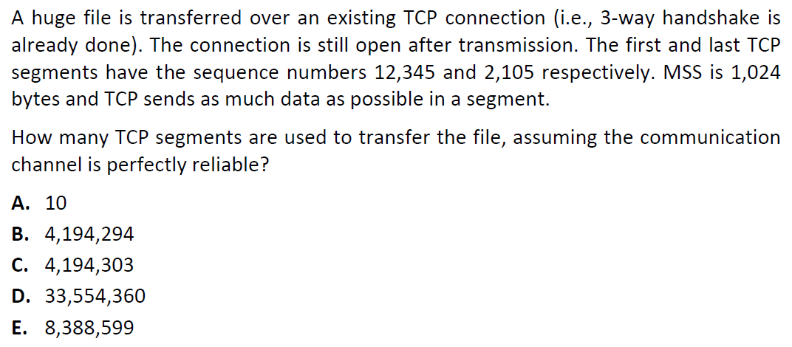
Extra Questions – super tricky!

Slide 29
Thank you!
Answers:
A, E, D, E

